Slide 1

ANÁLISIS DE DATOS ESPACIALES
EDIER V. ARISTIZÁBAL G.
Ing. Geólogo (Universidad Nacional de Colombia)
Esp. en Gestión de Riesgos Geológicos (Universidad de Ginebra – Suiza)
MSc. en Geociencias (Universidad de Shimane – Japón)
PhD. en Ingeniería (Universidad Nacional de Colombia)
Universidad Nacional de Colombia
Facultad de Minas
Departamento de Geociencias

Slide 2

REDES NEURONALES

Slide 3


Slide 4


Slide 5
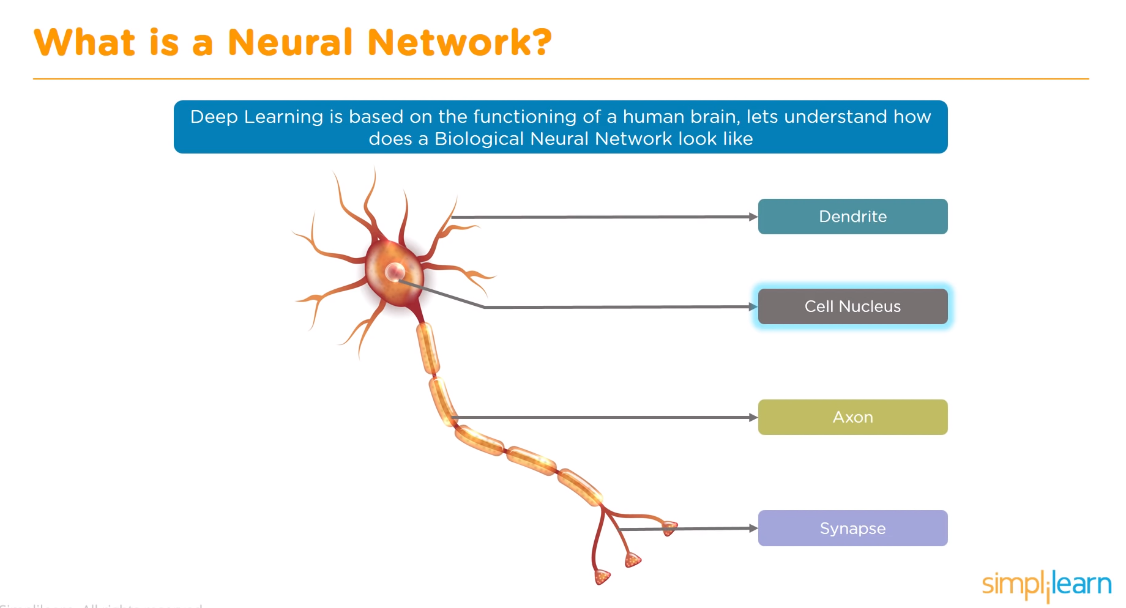

Slide 6
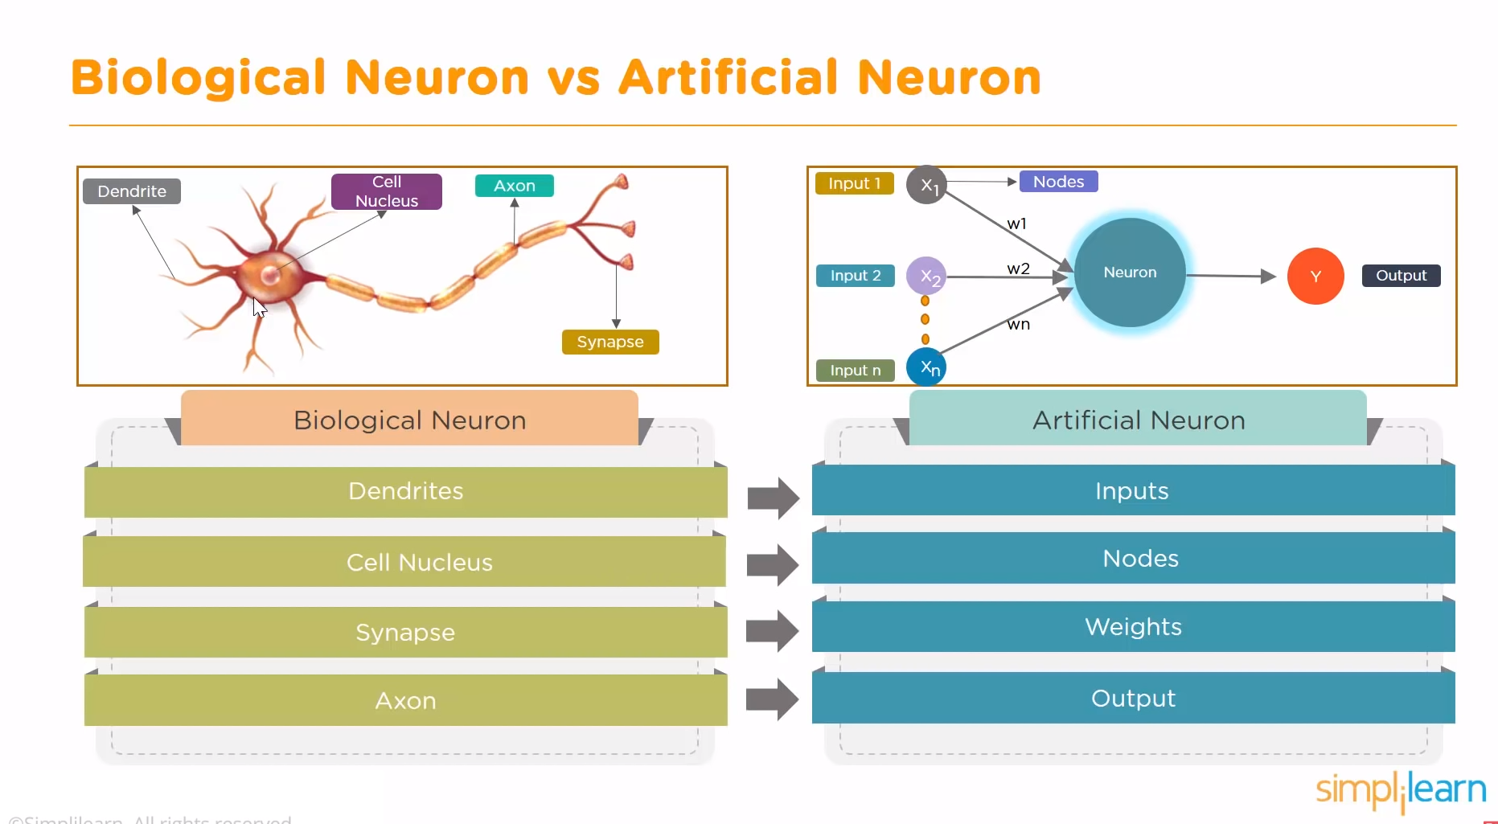

Slide 7

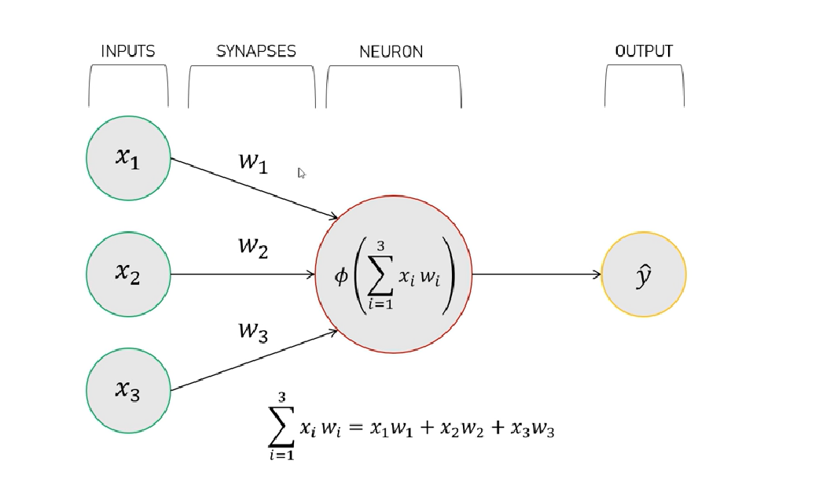
REDES NEURONALES

Slide 8
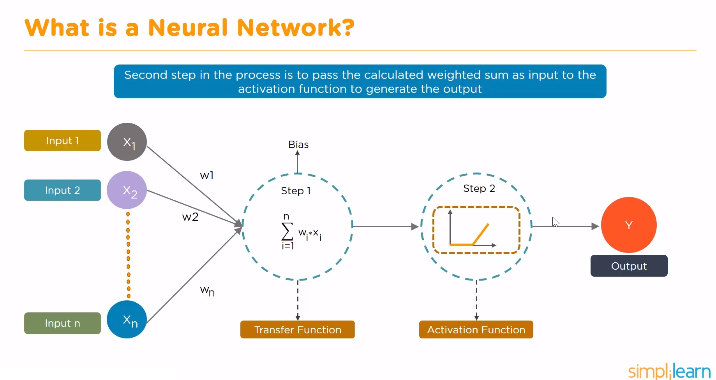

Slide 9
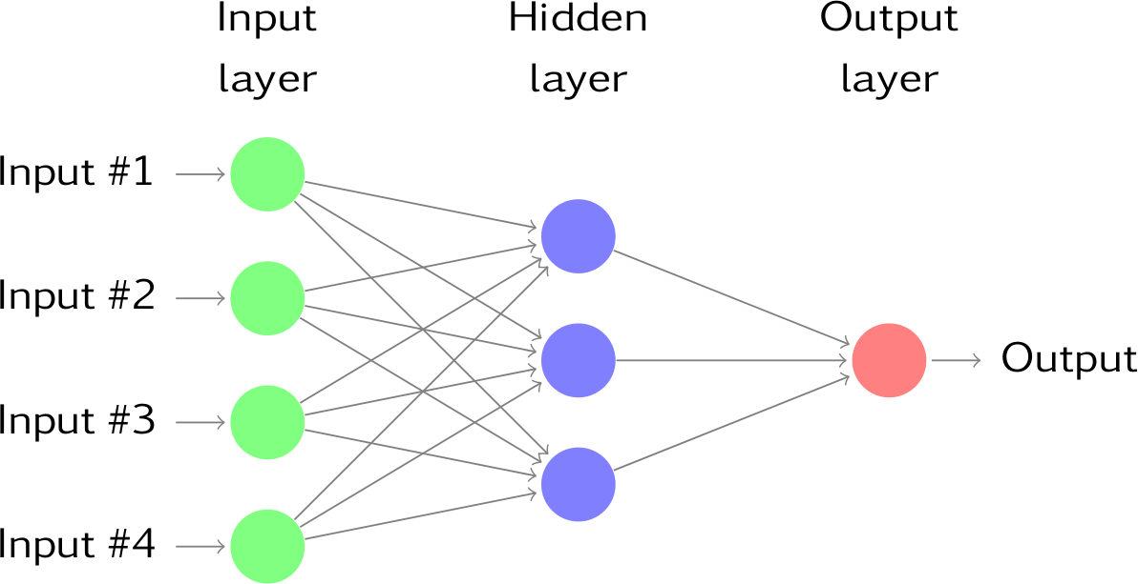
REDES NEURONALES

Slide 10
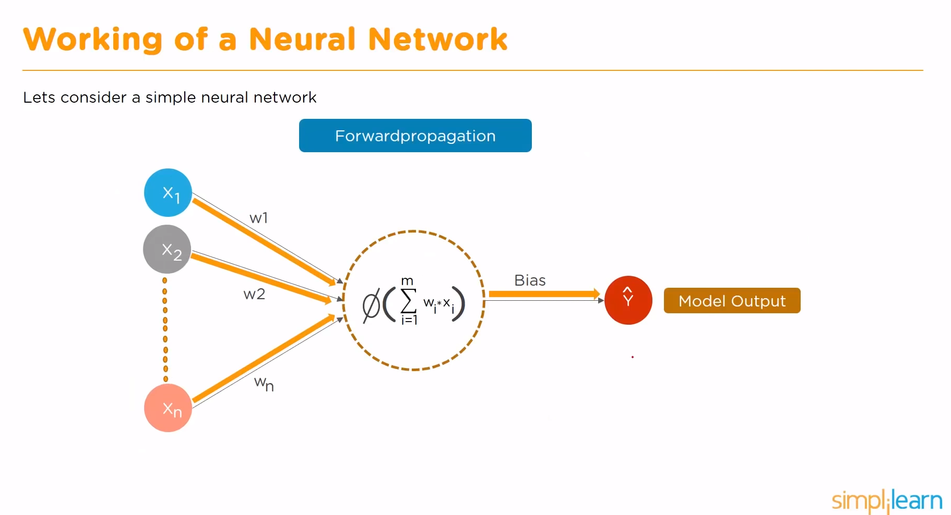

Slide 11
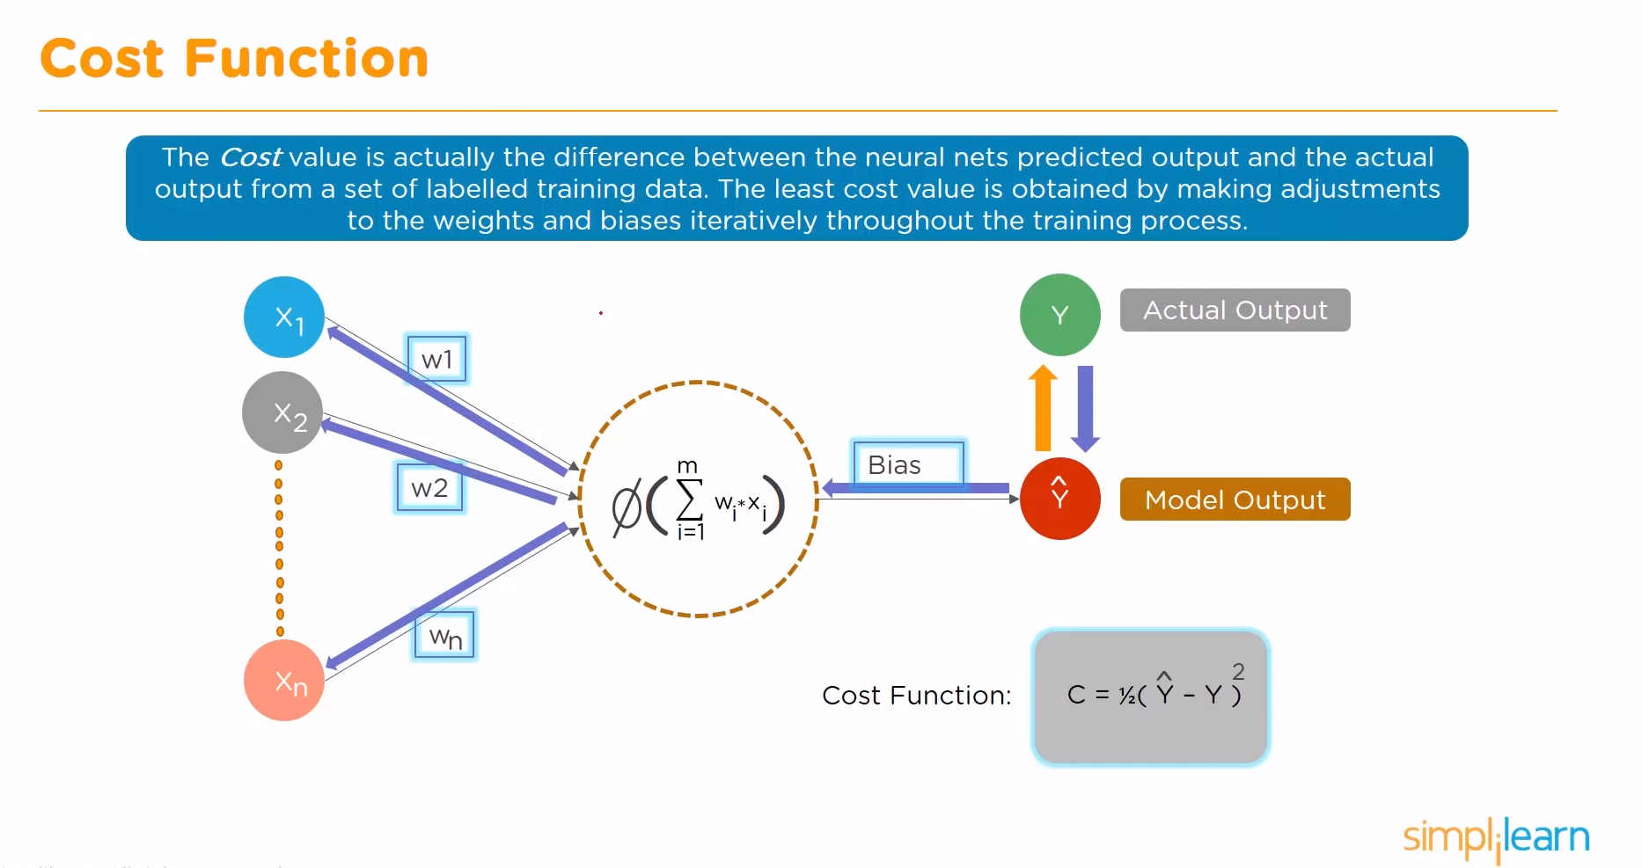

Slide 12
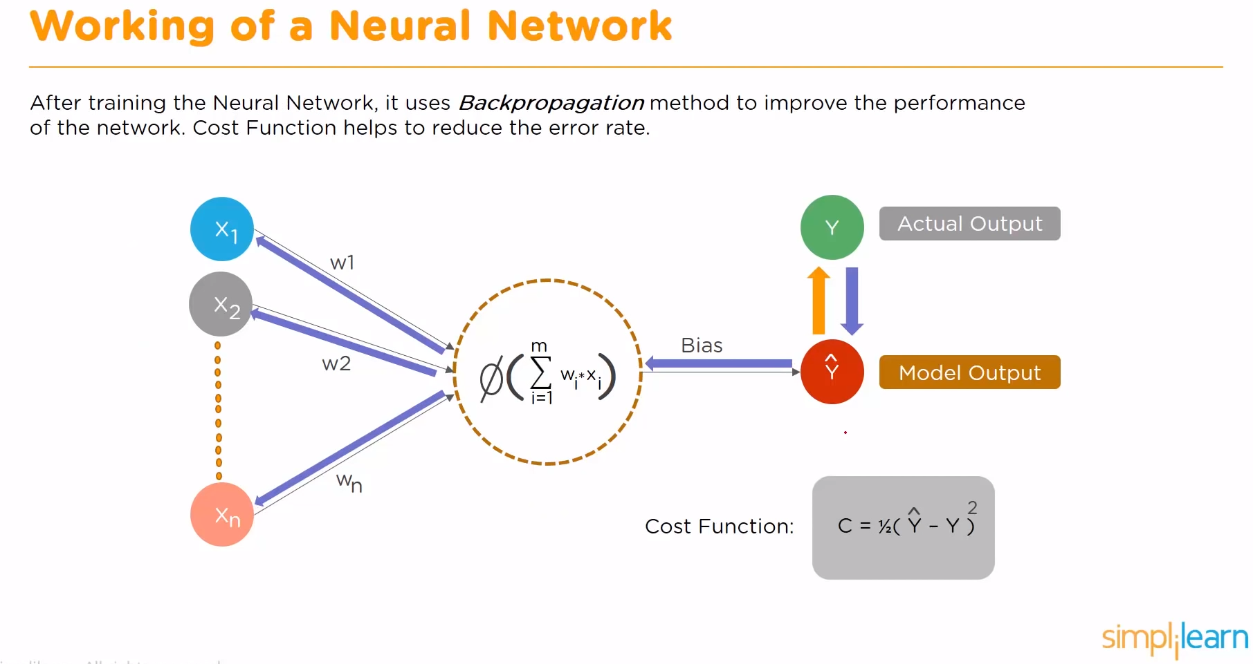

Slide 13
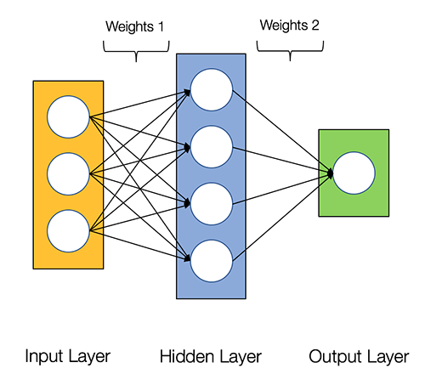
REDES NEURONALES
An input layer that accepts the independent variables or inputs of the model
One hidden layer
An output layer that generates predictions

Slide 14
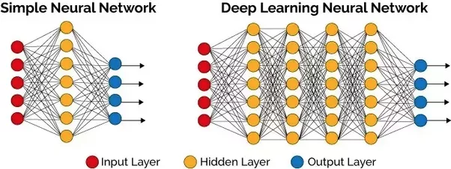
REDES NEURONALES

Slide 15
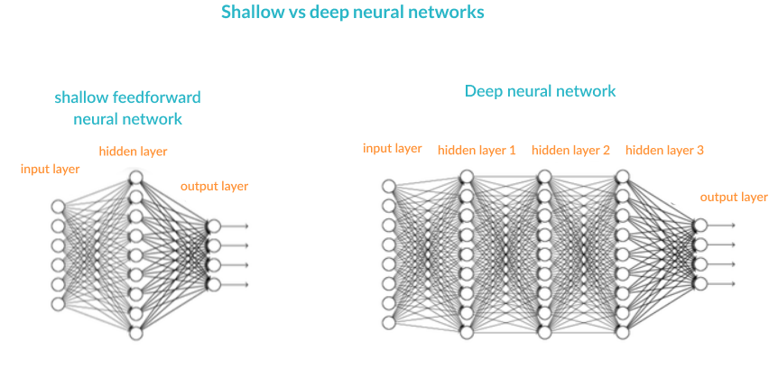
REDES NEURONALES

Slide 16
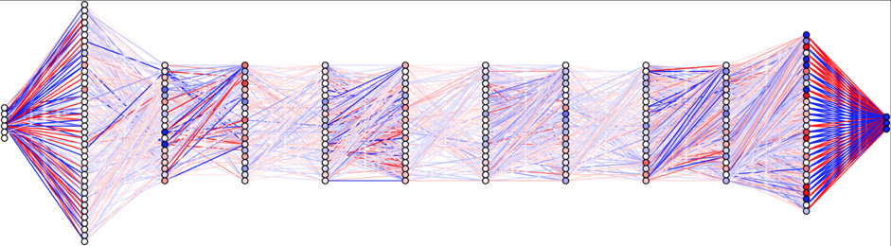
DEEP LEARNING

Slide 17
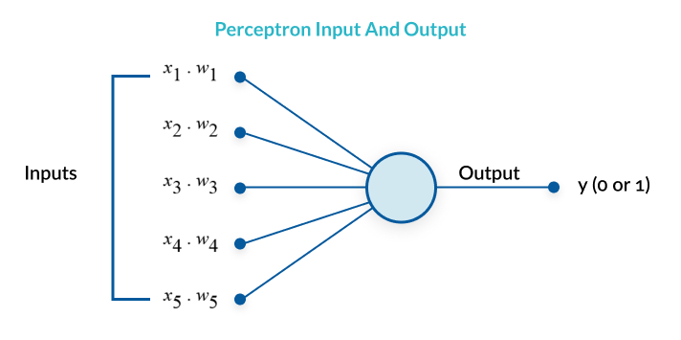
PERCEPTRON
A perceptron is a binary classification algorithm modeled after the functioning of the human brain—it was intended to emulate the neuron. The perceptron, while it has a simple structure, has the ability to learn and solve very complex problems.

Slide 18
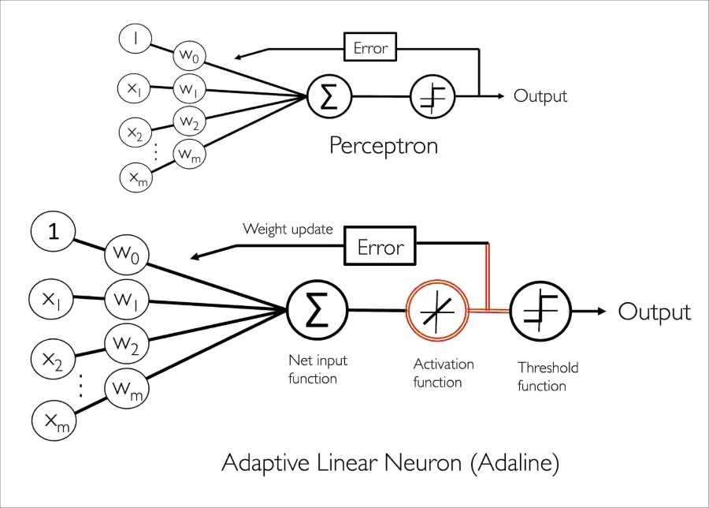
REDES NEURONALES

Slide 19
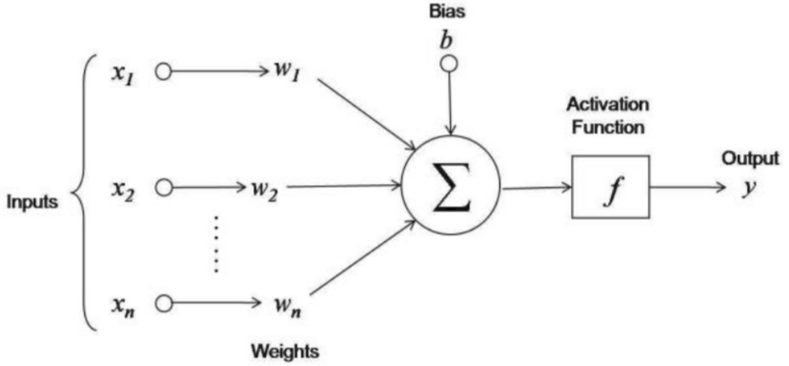
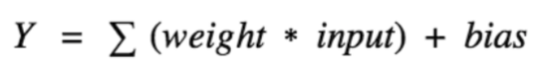
PROCESO DE APRENDIZAJE

Slide 20
ANN – Feedforward one layer

Slide 21
ANN – Feedforward multilayer

Slide 22
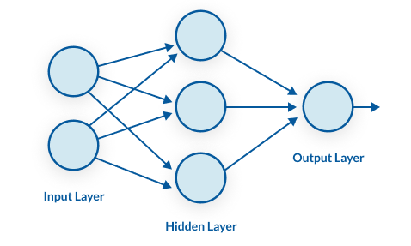
REDES NEURONALES
A multilayer perceptron (MLP) is a group of perceptrons, organized in multiple layers, that can accurately answer complex questions. Each perceptron in the first layer (on the left) sends signals to all the perceptrons in the second layer, and so on. An MLP contains an input layer, at least one hidden layer, and an output layer.

Slide 23
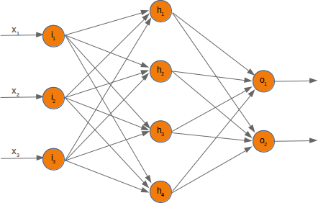
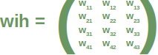
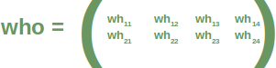
LEARNING PROCESSES

Slide 24
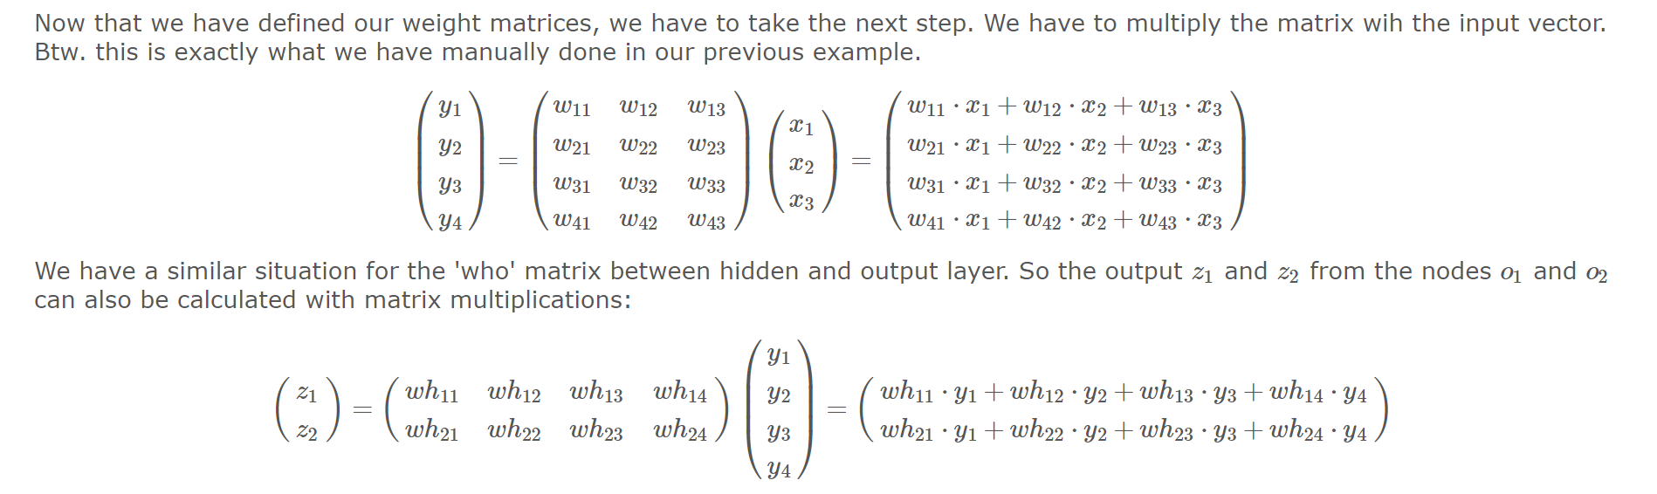
LEARNING PROCESSES

Slide 25
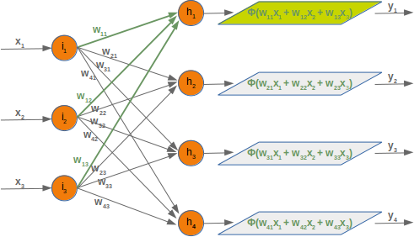
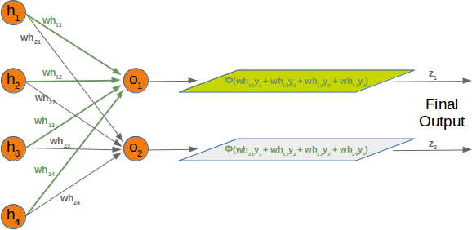
LEARNING PROCESSES
Forward

Slide 26
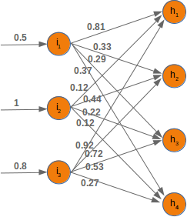
LEARNING PROCESSES
Ih1=0.81∗0.5+0.12∗1+0.92∗0.8
Ih2=0.33∗0.5+0.44∗1+0.72∗0.8
Ih3=0.29∗0.5+0.22∗1+0.53∗0.8
Ih4=0.37∗0.5+0.12∗1+0.27∗0.8

Slide 27
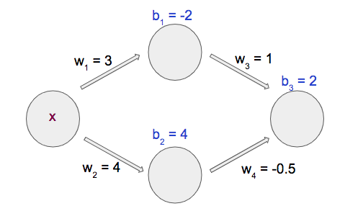
BIAS

Slide 28
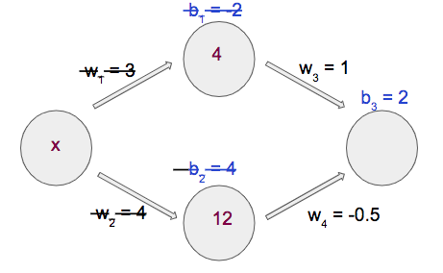
BIAS
X=2

Slide 29
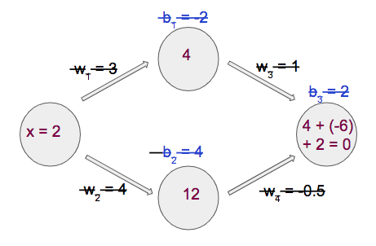
BIAS
X=2

Slide 30
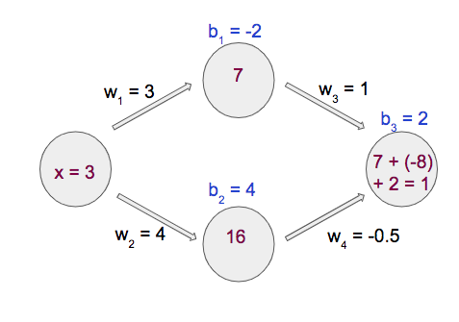
BIAS
With x =4 , our output is 2. x = 5 gets us an output of 3. x = 6 gets us an output of 4.

Slide 31
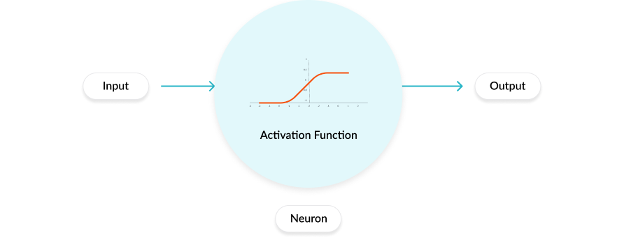
FUNCIÓN DE ACTIVACIÓN

Slide 32
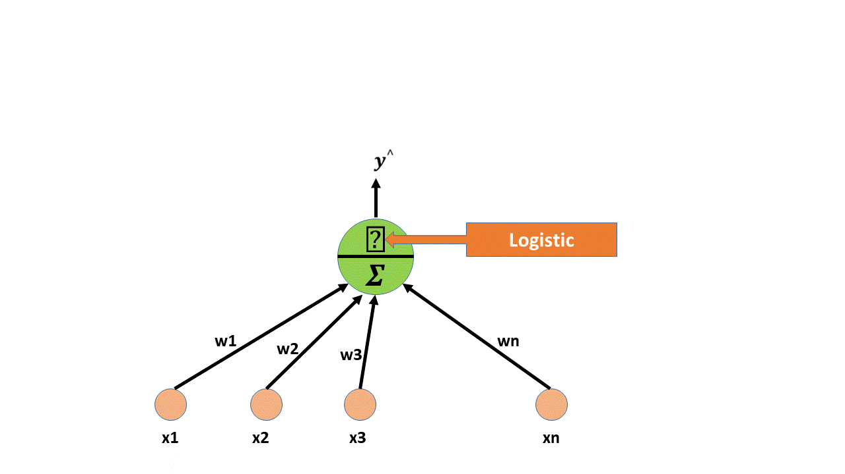
FUNCIÓN DE ACTIVACIÓN
(Vikashraj Luhaniwal, 2019) www.towardsdatascience.com

Slide 33
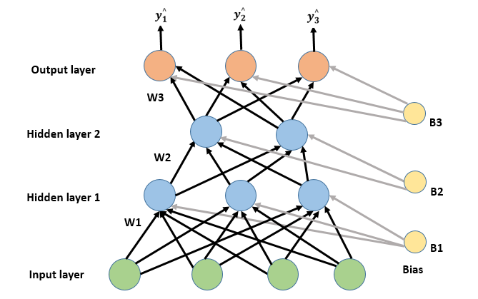
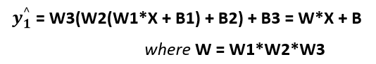
FUNCIÓN DE ACTIVACIÓN
→ Modelo Regresión Lineal
(Vikashraj Luhaniwal, 2019) www.towardsdatascience.com

Slide 34
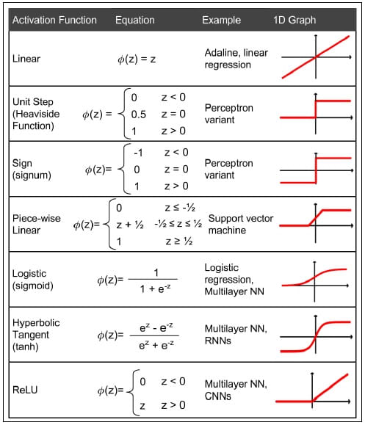
FUNCIÓN DE ACTIVACIÓN
ReLu (Rectified linear units)

Slide 35
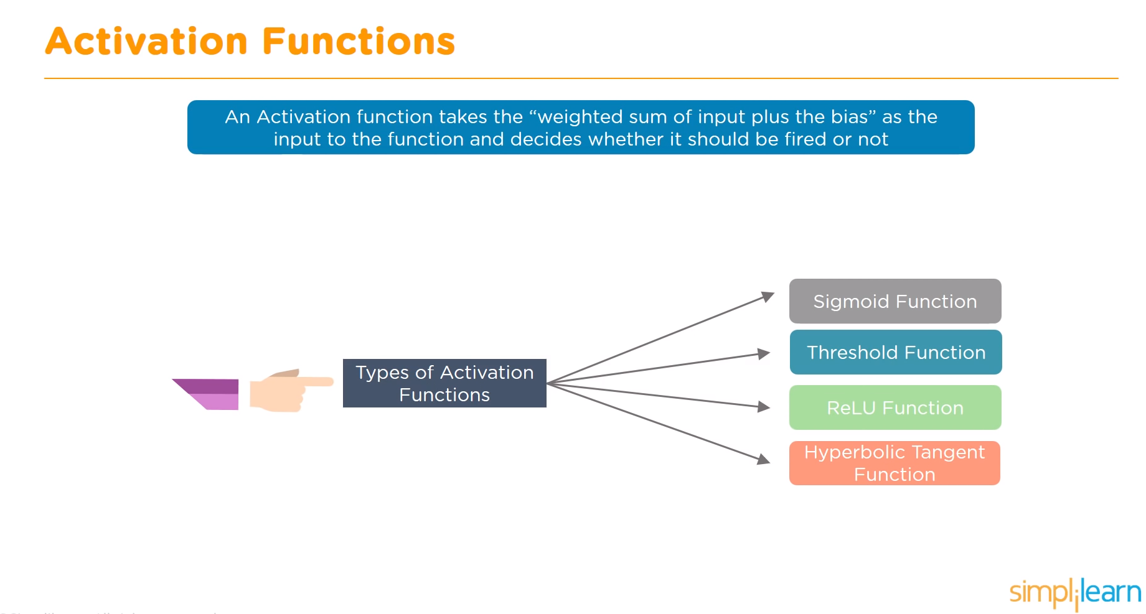

Slide 36
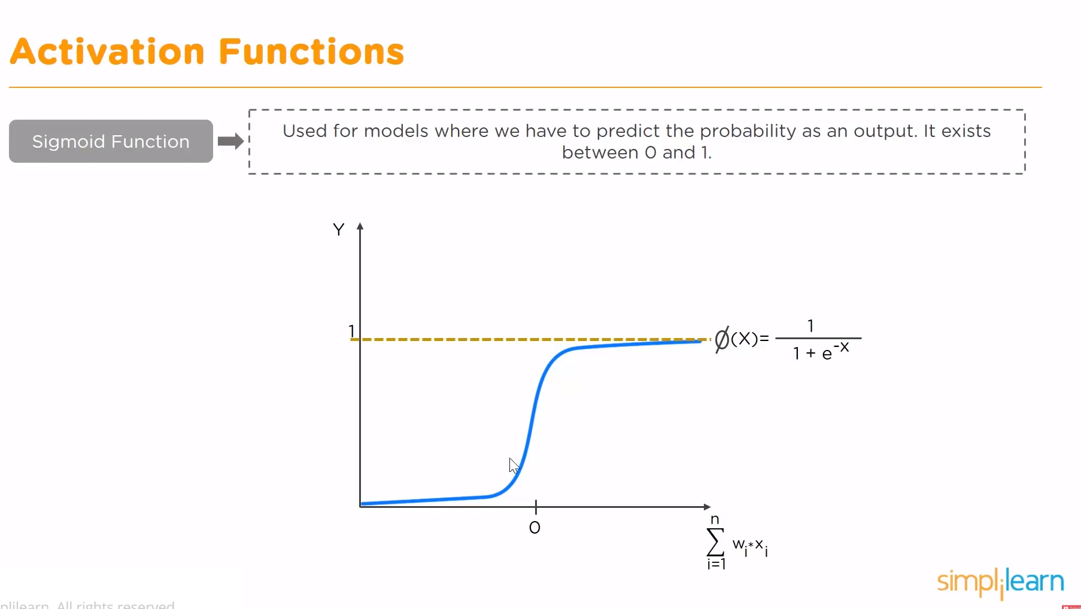
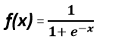
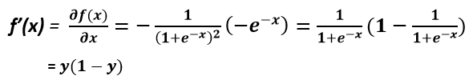
Derivada →
Saturated logistic neuron causes the gradient to vanish.
It is not a zero-centered function,
Because of e^x, it is highly compute-intensive which makes convergence slower.

Slide 37
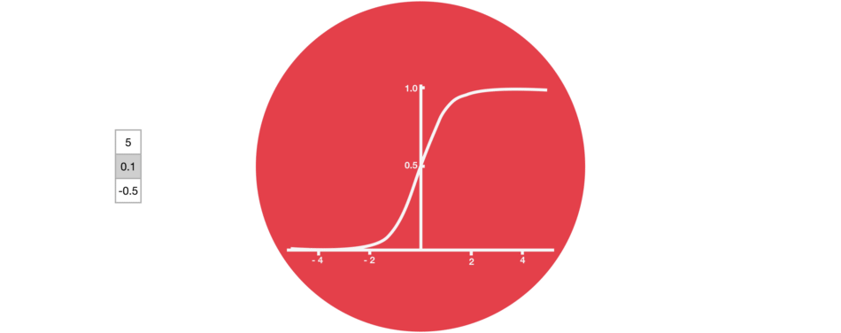

Slide 38
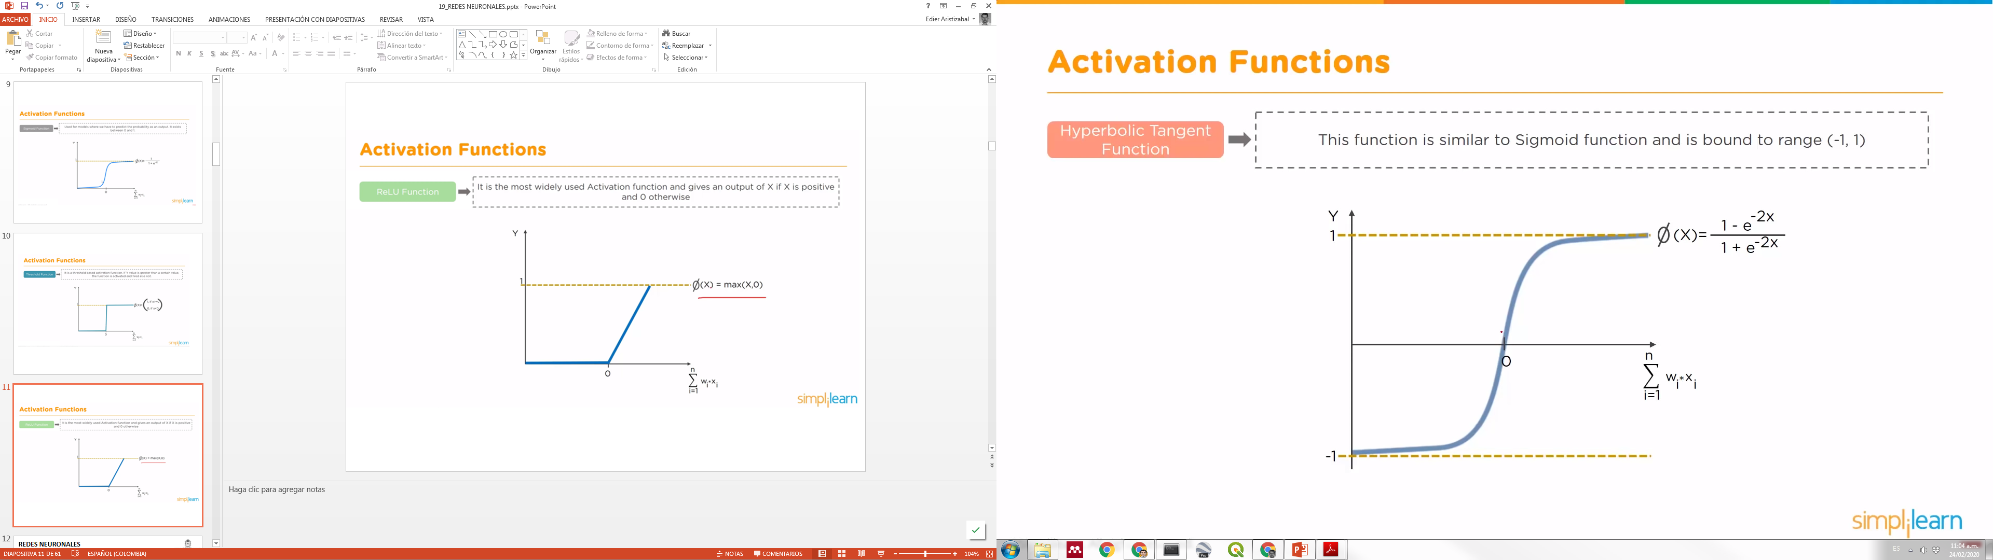
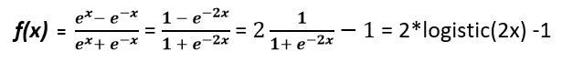
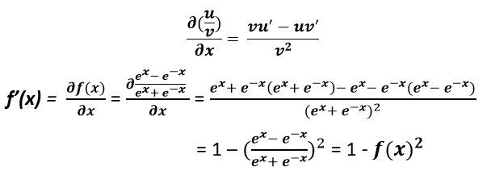
Saturated tanh neuron causes the gradient to vanish.
Because of e^x, it is highly compute-intensive.

Slide 39
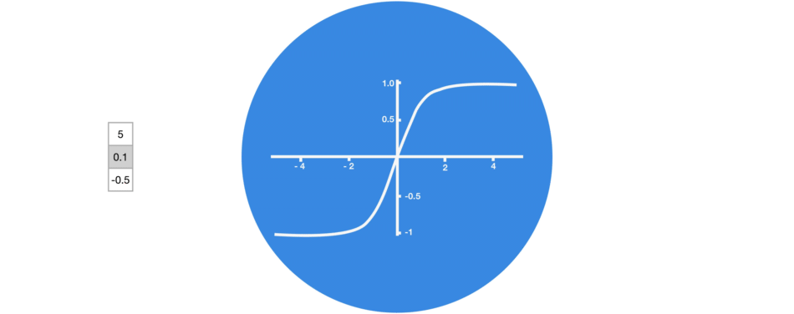
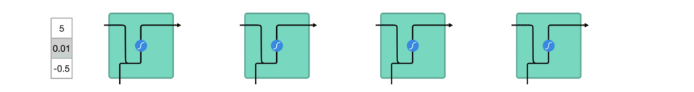

Slide 40
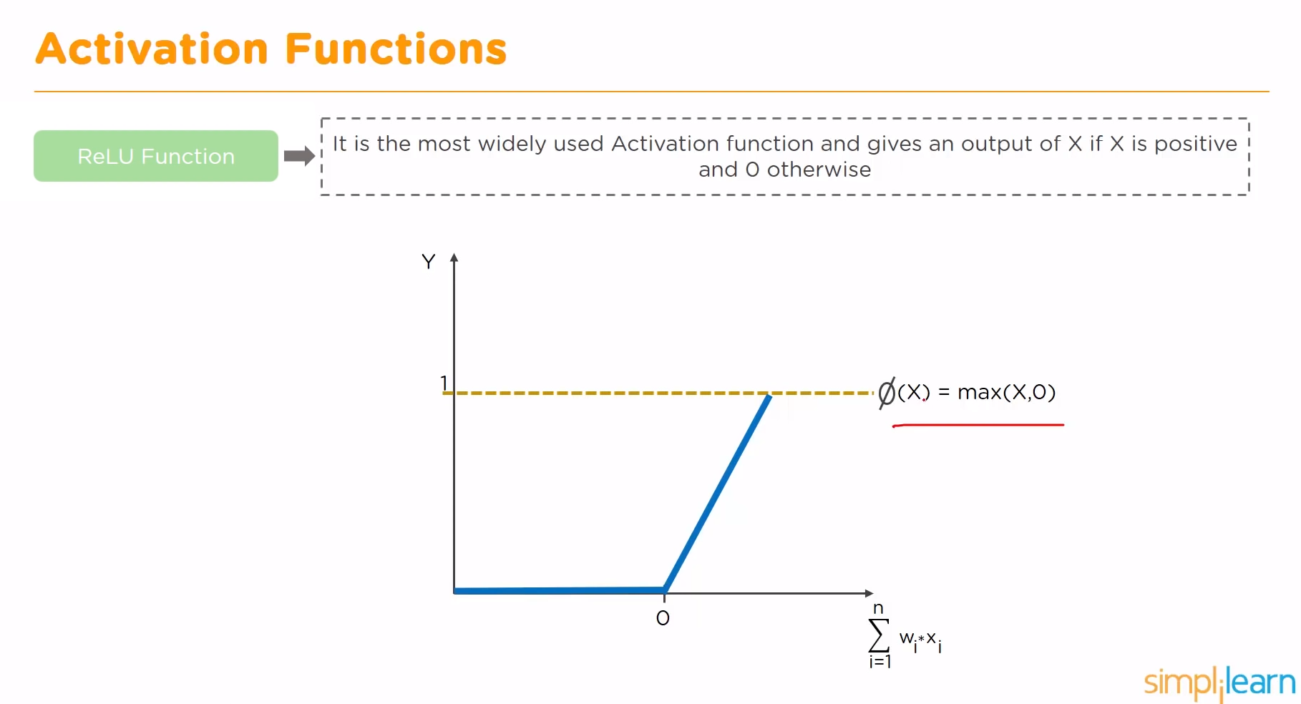
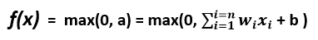
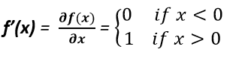
(Rectified linear units)
Dead Neurons
Easy to compute.
Does not saturate for the positive value of the weighted sum of inputs.
But still, ReLu is not a zero-centered function.

Slide 41
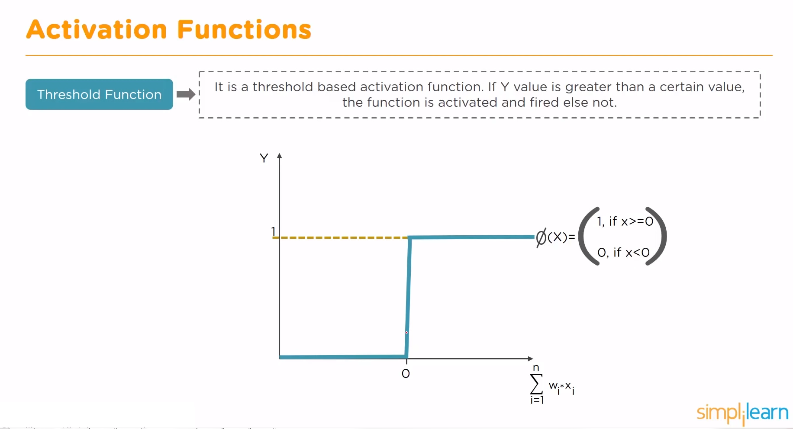

Slide 42
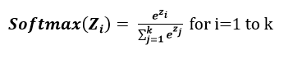
Softmax activation function
Softmax is used for multiclass classification problem
(Vikashraj Luhaniwal, 2019) www.towardsdatascience.com

Slide 43
activation functionS
which one to prefer?
As a rule of thumb, you can start with ReLu as a general approximator and switch to other functions if ReLu doesn't provide better results.
For CNN, ReLu is treated as a standard activation function but if it suffers from dead neurons then switch to LeakyReLu.
Always remember ReLu should be only used in hidden layers.
For classification, Sigmoid functions(Logistic, tanh, Softmax) and their combinations work well. But at the same time, it may suffer from vanishing gradient problem.
For RNN, the tanh activation function is preferred as a standard activation function.
(Vikashraj Luhaniwal, 2019) www.towardsdatascience.com

Slide 44
UNIVERSAL APPROXIMATION THEOREM
A feedforward network with a single layer is sufficient to represent any function, but the layer may be infeasibly large and may fail to learn and generalize correctly.
— Ian Goodfellow.

Slide 45
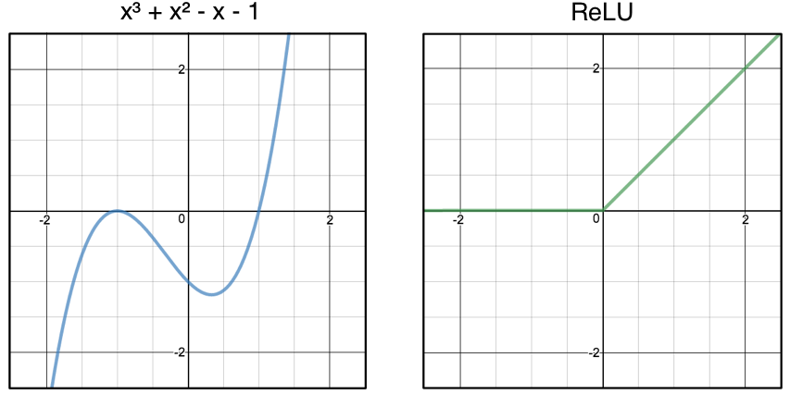
UNIVERSAL APPROXIMATION THEOREM

Slide 46
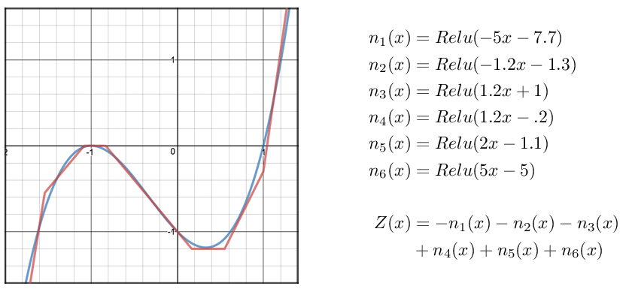
UNIVERSAL APPROXIMATION THEOREM

Slide 47

backpropagation

Slide 48

backpropagation

Slide 49

backpropagation

Slide 50


Slide 51




Loss function

Slide 52


Slide 53


Slide 54



Slide 55

REDES NEURONALES

Slide 56

REDES NEURONALES

Slide 57


Slide 58
PARÁMETROS CLAVES

Slide 59
PARÁMETROS CLAVES

Slide 60
REDES NEURONALES
https://playground.tensorflow.org/#activation=tanh&batchSize=10&dataset=circle&regDataset=reg-plane&learningRate=0.03&regularizationRate=0&noise=0&networkShape=4,2&seed=0.76228&showTestData=false&discretize=false&percTrainData=50&x=true&y=true&xTimesY=false&xSquared=false&ySquared=false&cosX=false&sinX=false&cosY=false&sinY=false&collectStats=false&problem=classification&initZero=false&hideText=false

Slide 61


Slide 62

ConvNets –CNN-

Slide 63


Slide 64


Slide 65

ConvNets –CNN-
There are five different layers in CNN
Input layer
Convo layer (Convo + ReLU)
Pooling layer
Fully connected(FC) layer
Softmax/logistic layer
Output layer

Slide 66

ConvNets –CNN-

Slide 67



Slide 68


Slide 69

CONVOLUTION LAYER – The kernel
The objective of the Convolution Operation is to extract the high-level features such as edges, from the input image.

Slide 70

CONVOLUTION LAYER – The kernel

Slide 71

CONVOLUTION LAYER – The kernel

Slide 72

STRIDE & PADDING

Slide 73

STRIDE
Stride denotes how many steps we are moving in each steps in convolution. By default it is one.

Slide 74

PADDING
We can observe that the size of output is smaller that input. To maintain the dimension of output as in input , we use padding. Padding is a process of adding zeros to the input matrix symmetrically. In the following example,the extra grey blocks denote the padding. It is used to make the dimension of output same as input.

Slide 75


Slide 76


Slide 77


Slide 78


Slide 79


Slide 80

POOLING LAYER
the Pooling layer is responsible for reducing the spatial size of the Convolved Feature. This is to decrease the computational power required to process the data through dimensionality reduction. Furthermore, it is useful for extracting dominant features which are rotational and positional invariant, thus maintaining the process of effectively training of the model

Slide 81

POOLING LAYER
There are two types of Pooling: Max Pooling and Average Pooling. Max Pooling returns the maximum value from the portion of the image covered by the Kernel. On the other hand, Average Pooling returns the average of all the values from the portion of the image covered by the Kernel.

Slide 82


Slide 83
FLATTENING
Now that we have converted our input image into a suitable form for our Multi-Level Perceptron, we shall flatten the image into a column vector. The flattened output is fed to a feed-forward neural network and backpropagation applied to every iteration of training. Over a series of epochs, the model is able to distinguish between dominating and certain low-level features in images and classify them using the Softmax Classification technique.

Slide 84


Slide 85

FULLY CONNECTED LAYER
Adding a Fully-Connected layer is a (usually) cheap way of learning non-linear combinations of the high-level features as represented by the output of the convolutional layer. The Fully-Connected layer is learning a possibly non-linear function in that space.

Slide 86


Slide 87
SOFTMAX / Logistic layer
Softmax or Logistic layer is the last layer of CNN. It resides at the end of FC layer. Logistic is used for binary classification and softmax is for multi-classification.

Slide 88

ConvNets –CNN-

Slide 89

ConvNets –CNN-

Slide 90

ConvNets –CNN-

Slide 91

CONVOLUTIONAL NEURONAL NETWORK CNN

Slide 92

ConvNets –CNN-

Slide 93

ConvNets –CNN-

Slide 94


Slide 95


Slide 96


Slide 97


Recurrence

Slide 98

–RNN-

Slide 99

–RNN-

Slide 100

–RNN-
Recurrent Neural Network remembers the past and it’s decisions are influenced by what it has learnt from the past. RNNs learn similarly while training, in addition, they remember things learnt from prior input(s) while generating output(s).

Slide 101



–RNN-
A basic RNN cell…
Kaushik Mani (ww.medium.com)

Slide 102


–RNN-
RNN are networks with loops in them, allowing information to persist.

Slide 103

–RNN-

Slide 104

–RNN-

Slide 105

–RNN-

Slide 106

–RNN-

Slide 107

–types of RNN-
No RNN
Kaushik Mani (ww.medium.com)

Slide 108


Slide 109

–RNN- one to many

Slide 110


Slide 111

–RNN- many to one

Slide 112


Slide 113

–RNN- many to many

Slide 114

RNN’s are not able to learn the information when the gap is large
GRU / LSTM

Slide 115


Slide 116

–RNN-
Andrej Karpathy blog

Slide 117

–RNN-
Andrej Karpathy blog

Slide 118


–RNN-
Michael Nguyen (www.towardsdatascience.com)

Slide 119

–RNN-
Michael Nguyen (www.towardsdatascience.com)

Slide 120

Raimi Karim (www.towardsdatascience.com)

Slide 121


Gated Recurrent Units -GRU-
Relevance gate
Michael Nguyen (www.towardsdatascience.com)

Slide 122

Raimi Karim (www.towardsdatascience.com)

Slide 123

Long Short Term Memory -LSTM-

Slide 124







Long Short Term Memory -LSTM-
Michael Nguyen (www.towardsdatascience.com)
Built by Oinkina with Hakyll using Bootstrap, MathJax, Disqus, MathBox.js, Highlight.js, and Footnotes.js.

Slide 125

Long Short Term Memory -LSTM-
Forget gate
Michael Nguyen (www.towardsdatascience.com)

Slide 126

Long Short Term Memory -LSTM-
Input gate
Michael Nguyen (www.towardsdatascience.com)

Slide 127

Long Short Term Memory -LSTM-
Cell state
Michael Nguyen (www.towardsdatascience.com)

Slide 128

Long Short Term Memory -LSTM-
Output gate
Michael Nguyen (www.towardsdatascience.com)

Slide 129

Raimi Karim (www.towardsdatascience.com)

Slide 130


LSTM Network
Long Short Term Memory networks – usually just called “LSTMs” – are a special kind of RNN, capable of learning long-term dependencies
The repeating module in a standard RNN contains a single layer.
The repeating module in an LSTM contains four interacting layers.

Slide 131
REDES NEURONALES
https://www.cs.cmu.edu/~aharley/vis/
https://www.cs.cmu.edu/~aharley/vis/fc/flat.html
https://www.cs.cmu.edu/~aharley/vis/conv/flat.html
https://cs.stanford.edu/people/karpathy/convnetjs/demo/cifar10.html

